Slide 1
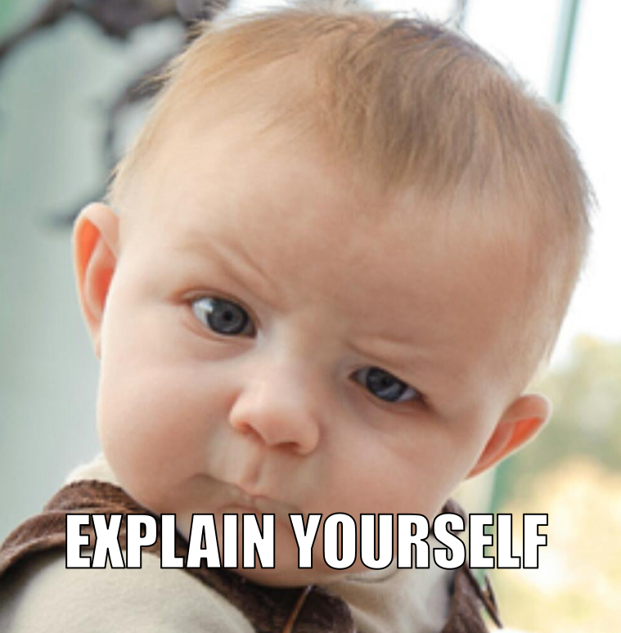
Babble Labble: Learning from Natural Language Explanations
Braden Hancock, Paroma Varma, Percy Liang, Chris Ré
DAWN Retreat 12 Sept 2017

Slide 2
Labeled data
+
Deep Learning
=
State of the Art

Slide 3
“How can I get enough labels?”

Slide 4
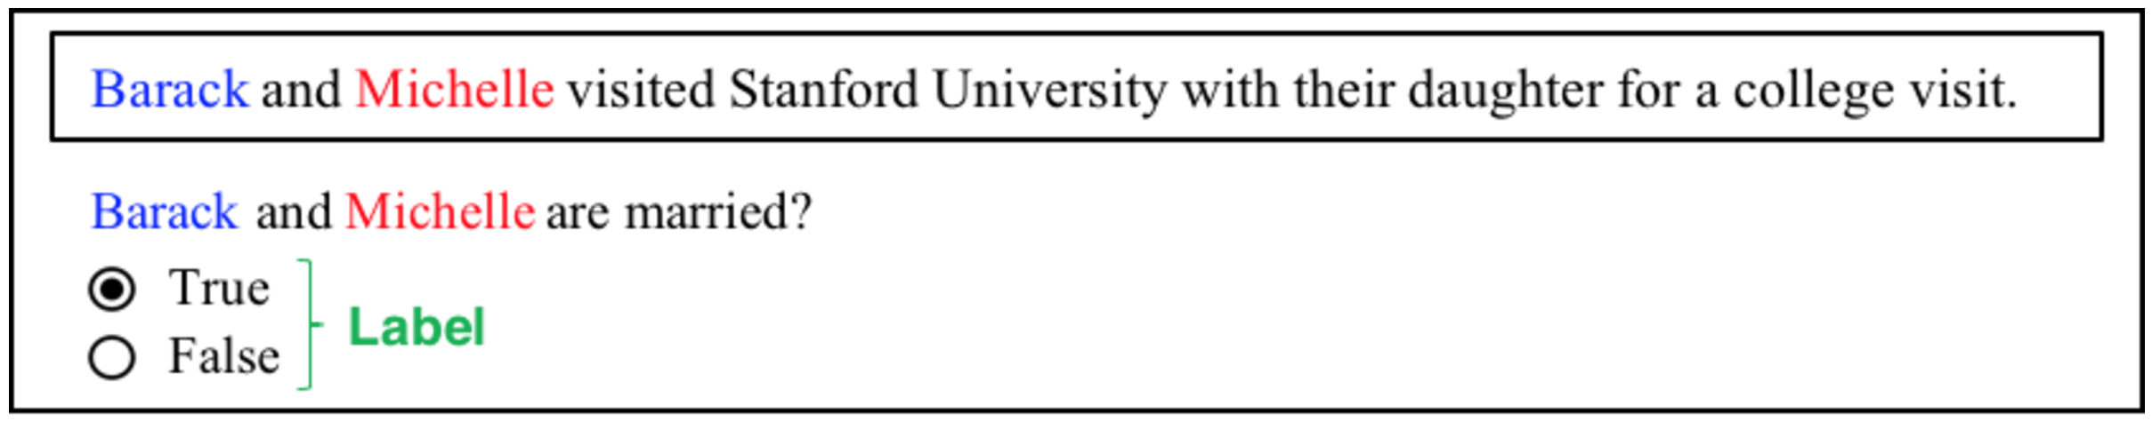
Option 1: With Labels (One by One)

Slide 5
Option 1: With Labels (One by One)

Slide 6
Option 1: With Labels (One by One)
Why?
Person1 is ‘Barack’
Person2 is ‘Michelle’
Visited is after Person2
Stanford University is in the sentence
‘and’ is between Person1 and Person2
Person1 is the first word in the sentence
‘and’ is the second word in the sentence
Person3 is the third word in the sentence
…
‘their daughter’ is after Person1 and Person2 in the sentence
…
Notes:
Collecting supervision one bit (one binary label) at a time leaves a lot of signal on the table.

Slide 7
“You’re getting warmer….”

Slide 8
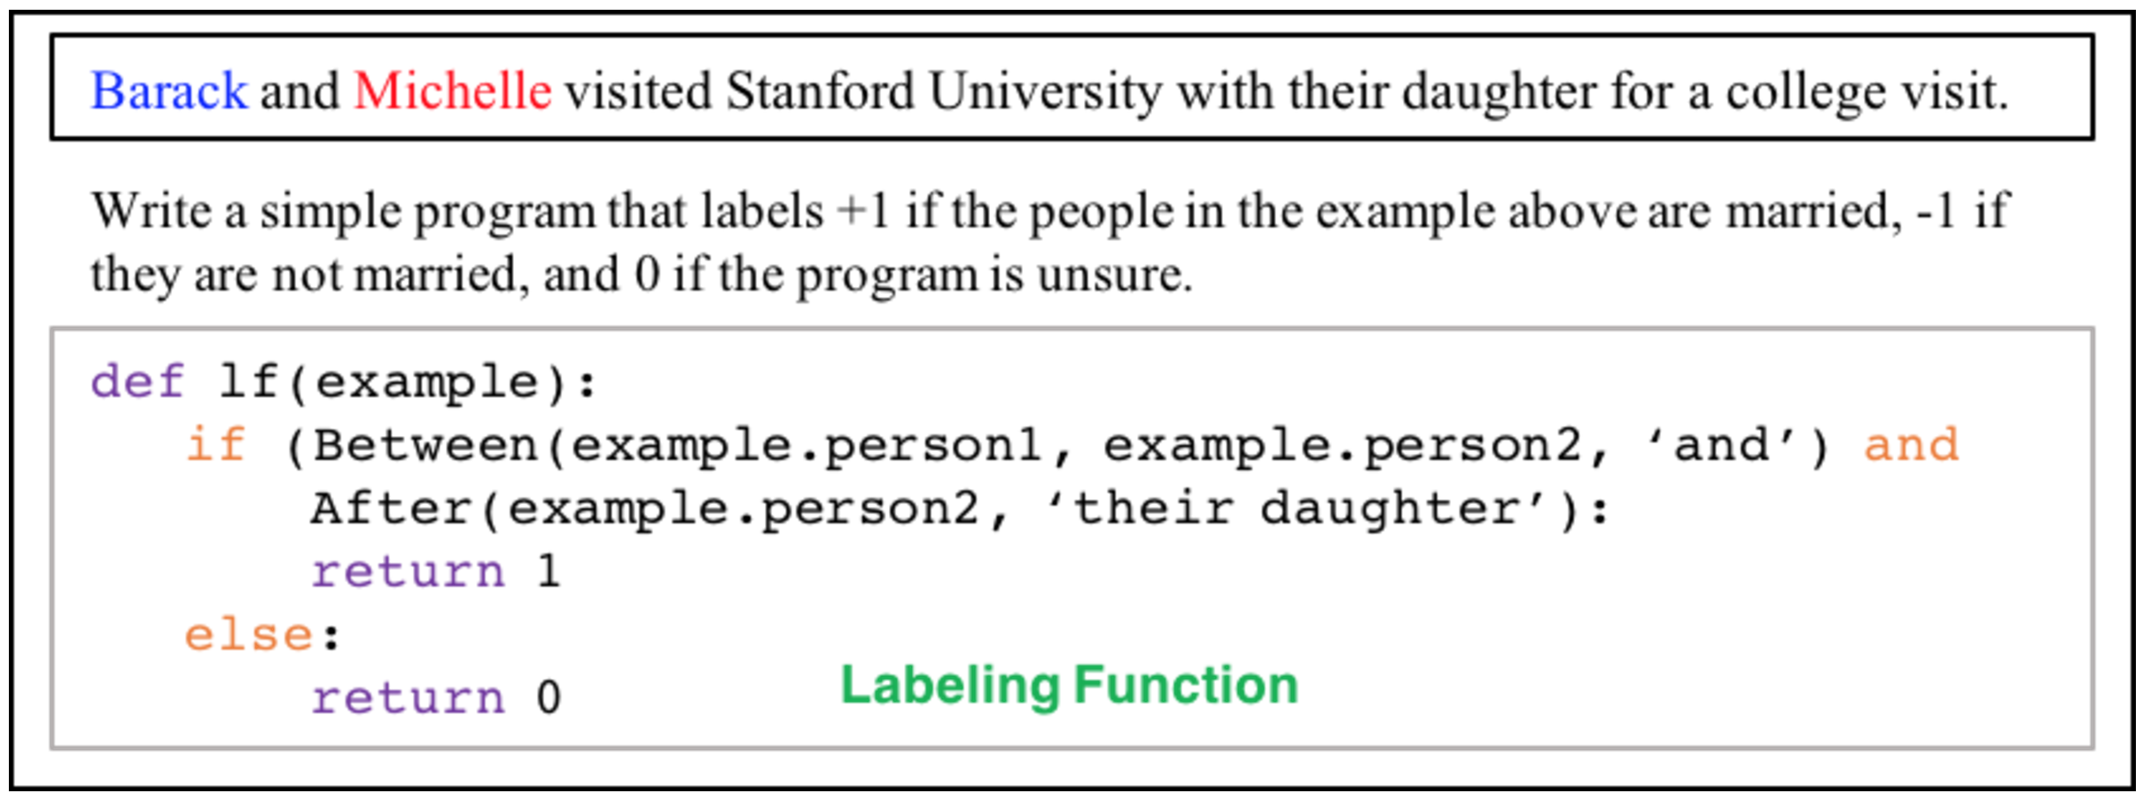
Option 2: With Labeling Functions (DP)

Slide 9
Option 2: With Labeling Functions (DP)
Pro:
Labeling scales (label 1000 examples at a time)
Con:
Not everyone can (or wants to) write programs!

Slide 10
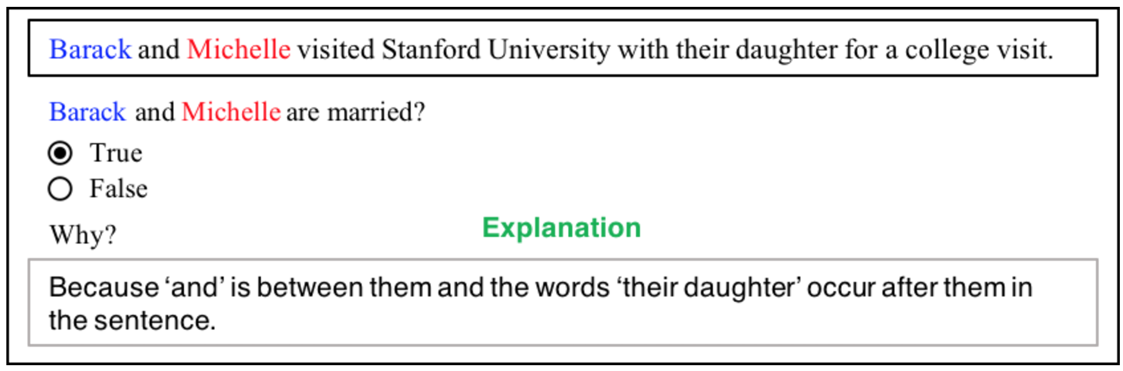
Option 3: With Explanations (Babble Labble)

Slide 11
Option 3: With Explanations (Babble Labble)
Pros:
Ease of use
Faster supervision
More sources of supervision
10x faster?
1000x more?
More people in the world can talk than can program
More written text in the world than programs

Slide 12
Accessibility
Low
High
Low
Manual
Labeling
Scalability
Labeling
Functions
Babble
Labble
High

Slide 13
Natural Language is Ambiguous

Slide 14
Babble Labble Framework
Unlabeled Examples
Candidate
LFs
Passing
LFs
Probabilistic
Labels
Semantic Parser
Filter Bank
Label Aggregator
0.86
0.65
0.12
0.73
0.27
Explanations

Slide 15
Semantic Parser
Natural Language
Candidate Programs
Before(‘wife’, B)
Correct
Semantic Parser
Before(B, ‘wife’)
Spurious
“‘wife’ precedes B in the sentence”
In(B, Sentence)
In(“’wife’ precedes B”, Sentence)
And(Before(‘wife’, B), In(B, Sentence))
Notes:
Traditionally this is where labeled data would be used to learn to rank the candidate programs.

Slide 16
Spurious Programs
Example X:
A B
Barack and his wife Michelle live in the White House.
Explanation Y:
“‘wife’ precedes B in the sentence”
Candidate Programs:
#
Program
Observations
1
Before(‘wife’, B)
Correct
2
Before(B, ‘wife’)
False for X
3
In(B, Sentence)
Trivially True for all examples
4
After(B, ‘wife’)
Redundant with LF #1

Slide 17
Filter Bank
Example consistency
Uniform signature
Redundant signature
Input: X has label because Y
Parse: Y -> LF_{Y}
Evaluate: LF_{Y}(X) =
Inconsistent: ≠
LF 1:
LF 1:
LF 2:

Slide 18
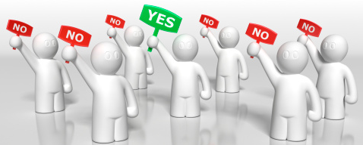
Label Aggregator
Model the LFs’ accuracies
Model the LFs’ dependencies
(Probably Wrong)
=
vs
=
Exp 1
Exp 2
Exp 3
Exp 4

Slide 19
Spurious LFs can still be helpful
Intended:
Misinterpreted as:
“‘their daughter’ precedes the people”
“the people are preceded by ‘their daughter’”
Following the birth of their daughter, Beyoncé and Jay-Z took to Twitter to celebrate.
“their daughter”

Slide 20
Being “Accurate Enough”
Data Programming: Feed a larger set of “accurate enough” labels
to the discriminative model
Babble Labble: Feed a larger set of “accurate enough” LFs
to the generative model

Slide 21
Experiment: Chemical-Disease Relations
True – “because ‘induced by’, ‘caused by’, or ‘due to’ is between the disease and the chemical”
False – “because a treatment word is between the chemical and the disease and the chemical is within 100 characters to the left of the disease”
False – “because the pair of canonical IDs of the chemical and the disease is in the therapeutic combinations dictionary”
contradiction
redundant
uniform
=
-
(
+
+
)
=
30 explanations
61 LFs
18 LFs
6 LFs
1 LF
36 LFs
Filters

Slide 22
Experiment: Chemical-Disease Relations
1000 gold labels
=
30 explanations
F1 = 0.53
F1 = 0.53
*33x fewer inputs

Slide 23
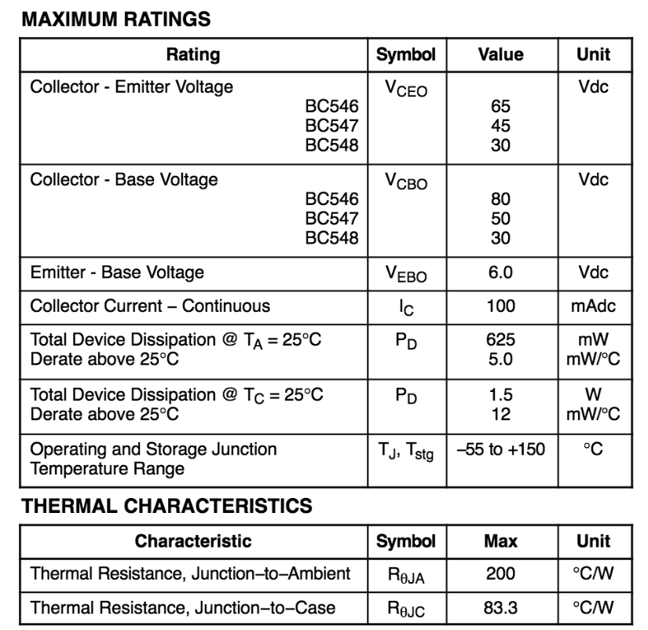
Expanding to More Domains
Images
Text
Tables
A popular screen star, Lily, who is the daughter of British rocker Phil Collins and his American wife Jill Tavelman, was the ideal guest at the film premiere. Her next project is an untitled Warren Beatty biopic on Howard Hughes that is due to be released in 2016.
B
A
“Is person A riding
bike B?”
“Are person A and Person B
married?”
“Is Value A the collector-base
voltage of Part B?”

Slide 25
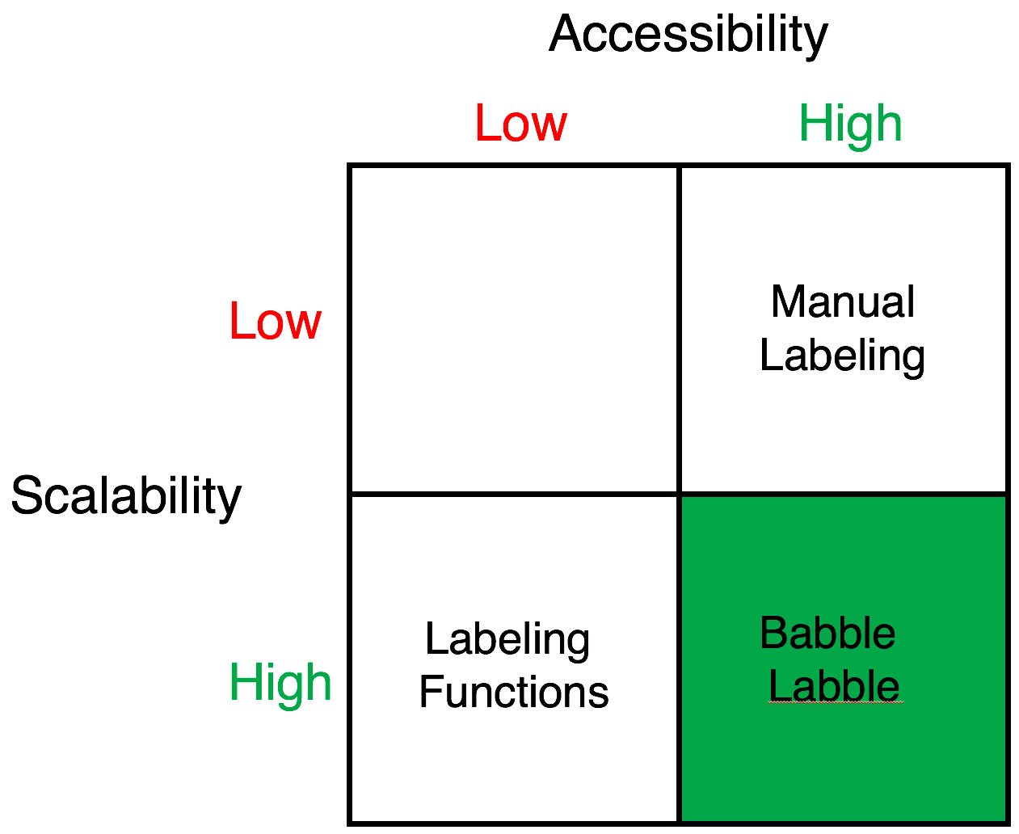
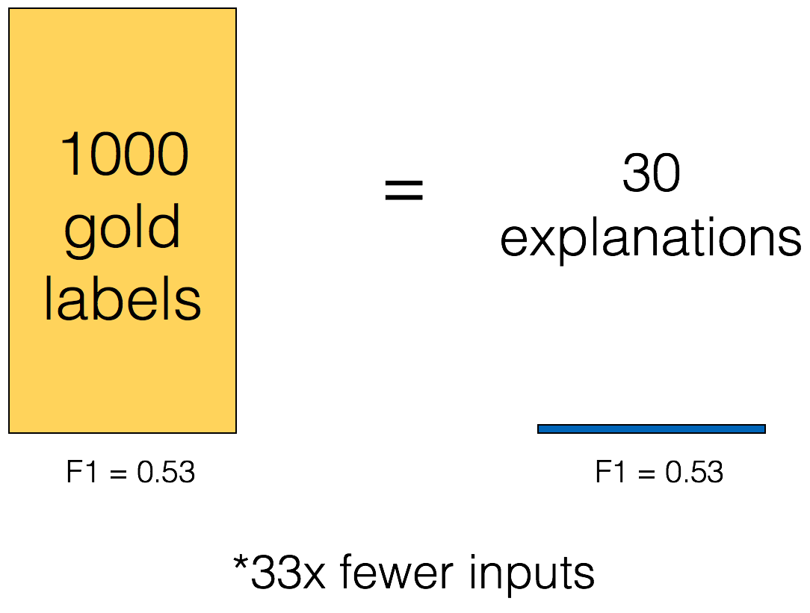
Babble Labble: Learning from Natural Language Explanations
Bob and his wife Alice visited Stanford University last Thursday.
Do you think Bob and Alice are married?
Yes
No
Why?
Because the words ‘his wife’ are immediately to the left of Alice.
Notes:
One-slide speed pitch

